Slide 1
Genome Assembly and Annotation
Best Practices, Best Tools

Slide 2
Structure
AIM:
Help you develop a strategy for performing a genome assembly and assessing its quality
Theory
Sequence Types
Algorithm Basics
Assessing an Assembly
Tools
For Assembly
For Assessment

Slide 3
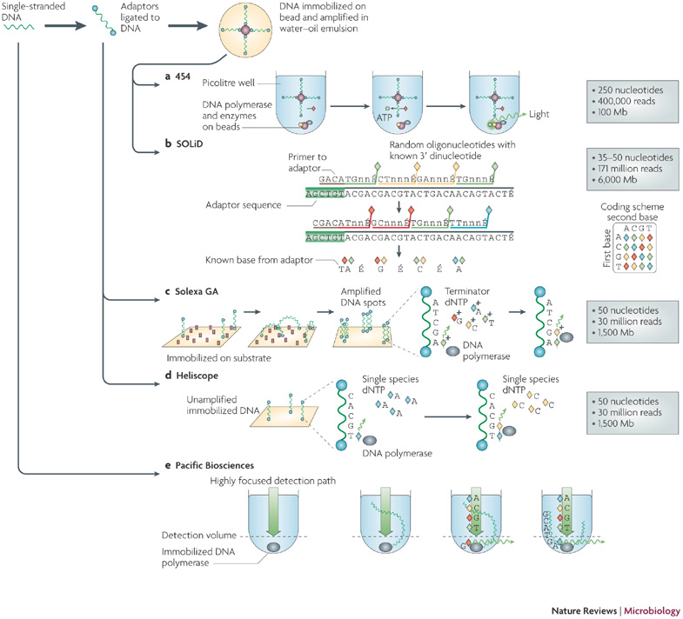
Sequencing
Two major kinds
- Illumina
- Pacific BioSciences
Illumina
Sequence by Synthesis
PacBio
Single Molecule Real Time

Slide 4
Paired-end and Mate Paired Reads
Paired End
Read both ends of the molecule
Separated by ~ 500 bp
Mate Pair
Circularize long molecules (1-10kbp)
Shear into fragments then sequence

Slide 5
Brief sequence comparison
 | Illumina | PacBio
Length | <300bp | <10kb
Reads per run | 25 – 400 million | ~50 thousand
accuracy | >99% | ~86%

Slide 6
The Assembly Problem
Rebuilding a shredded text
Rick Astley accidentally shreds the lyrics to his first album…
Never gonna give you up, never gonna let you down, Never gonna run around and desert you, Never gonna make you cry, never gonna say goodbye, Never gonna tell a lie and hurt you
Never gonna give
gonna give you up, never
never gonna let you down
never gonna
you down, Never gonna run
Never gonna
give you up, never
give you up, never gonna let you
let you down, Never
never gonna let you down,
down, Never gonna
How can he put them back together?
The fragments from all copies are mixed together
Some are identical

Slide 7
Greedy Algorithm
Never gonna
Never gonna give
gonna give you up, never
never gonna
Never gonna give
never gonna let
Repeated sections make the proper assembly ambiguous

Slide 8
de Bruijn Graph
Make all ‘k’ length fragments
Network of possible directional links – from overlaps
Never gonna give
gonna give you up

Slide 9
de Bruijn Graph Assembly
gonna run around
Never gonna give
never gonna run
gonna give you up
you up never gonna
never gonna let you down
down, Never gonna
Build Graph and simplify

Slide 10
de Bruijn Graph Assembly
never gonna run around
Never gonna give you up
You up never gonna
never gonna let you down
down, Never gonna
Build graph and simplify

Slide 11
Assembling a genome
1. Shear and sequence DNA
2. Make assembly graph from overlapped reads
AGCCTTAGACCTACAGGATGCGCGCACAGT
GATGCGCGCACAGTAGCCTTAGACT
3. Simplify assembly graph
4. Detangle graph with long reads, mate pairs and other links

Slide 12
Why are genomes hard to assemble?
Biological Problems
Polyploidy, heterozygosity
Repeats, repeats
Sequencing problems
Large genomes genome >>> reads
sequence read errors
3. Computational
Very large genomes
Complex repeat structure
Accuracy
What is correct assembly?
How do we tell?

Slide 13
What you need for a good assembly
Coverage
Oversample
Read Length
Longer than repeats
Quality
Errors mess up overlaps

Slide 14
Coverage
Times sampled
Some segments may not even be sequenced!

Slide 15
Read Length and Repeats
Times sampled
Assembly length increases with read length, especially when it passes the repeat length

Slide 16
Scaffolding
Contigs end at
- coverage gaps
- errors
- repeat boundaries
Use paired end/mate information to place contigs relative to each other
- has gaps

Slide 17
Assembly Tools
Loads! Including but not limited to ..
SOAPdenovo, HyDA, ABySS, ALLPATHS-LG, Velvet, Celera, PacBio Corrected Reads, Mira, meraculous, Newbler, Ray, SGA, CLC Assembly Cell …

Slide 18
Assembly Tools
SOAPdenovo
Celera Assembler

Slide 19
Short read assembly
SOAPdenovo
Get a big computer
Different specs for every genome and sequence data.
> 128Gb RAM for Pathogen genomes
> 1Tb for Plant genomes

Slide 20
Error Correction of Reads

Slide 21
Long read assembly
Celera Assembler

Slide 22
Hybrid assembly
1. Map Illumina reads to PacBio reads to correct errors
2. Assemble

Slide 23
Assessing an assembly
N50
50 % of genome in contigs longer than the N50 contig
Massively Abused!!

Slide 24
Assessing an assembly
Visual Graph Inspection - Bandage
Allows easy visualisation of some graphs. Assess structure (and sanity) of the assembly

Slide 25
Assessing an assembly
Internal contig consistency
Align original reads to contigs.
Do they all align without breaks?
Is the distance between pairs consistent?
Is coverage as expected?

Slide 26
Assessing an assembly
Gene Content
Core Orthologues – are they all there?
BUSCO – identify and quantify completeness of core orthologues per clade in an assembly

Slide 27
Acknowledgements
Michael Schatz @ CSHL
References and slides
https://github.com/danmaclean/mpmi_training

